Slide 1



Ola Dashboard
View in Power BI

Slide 2
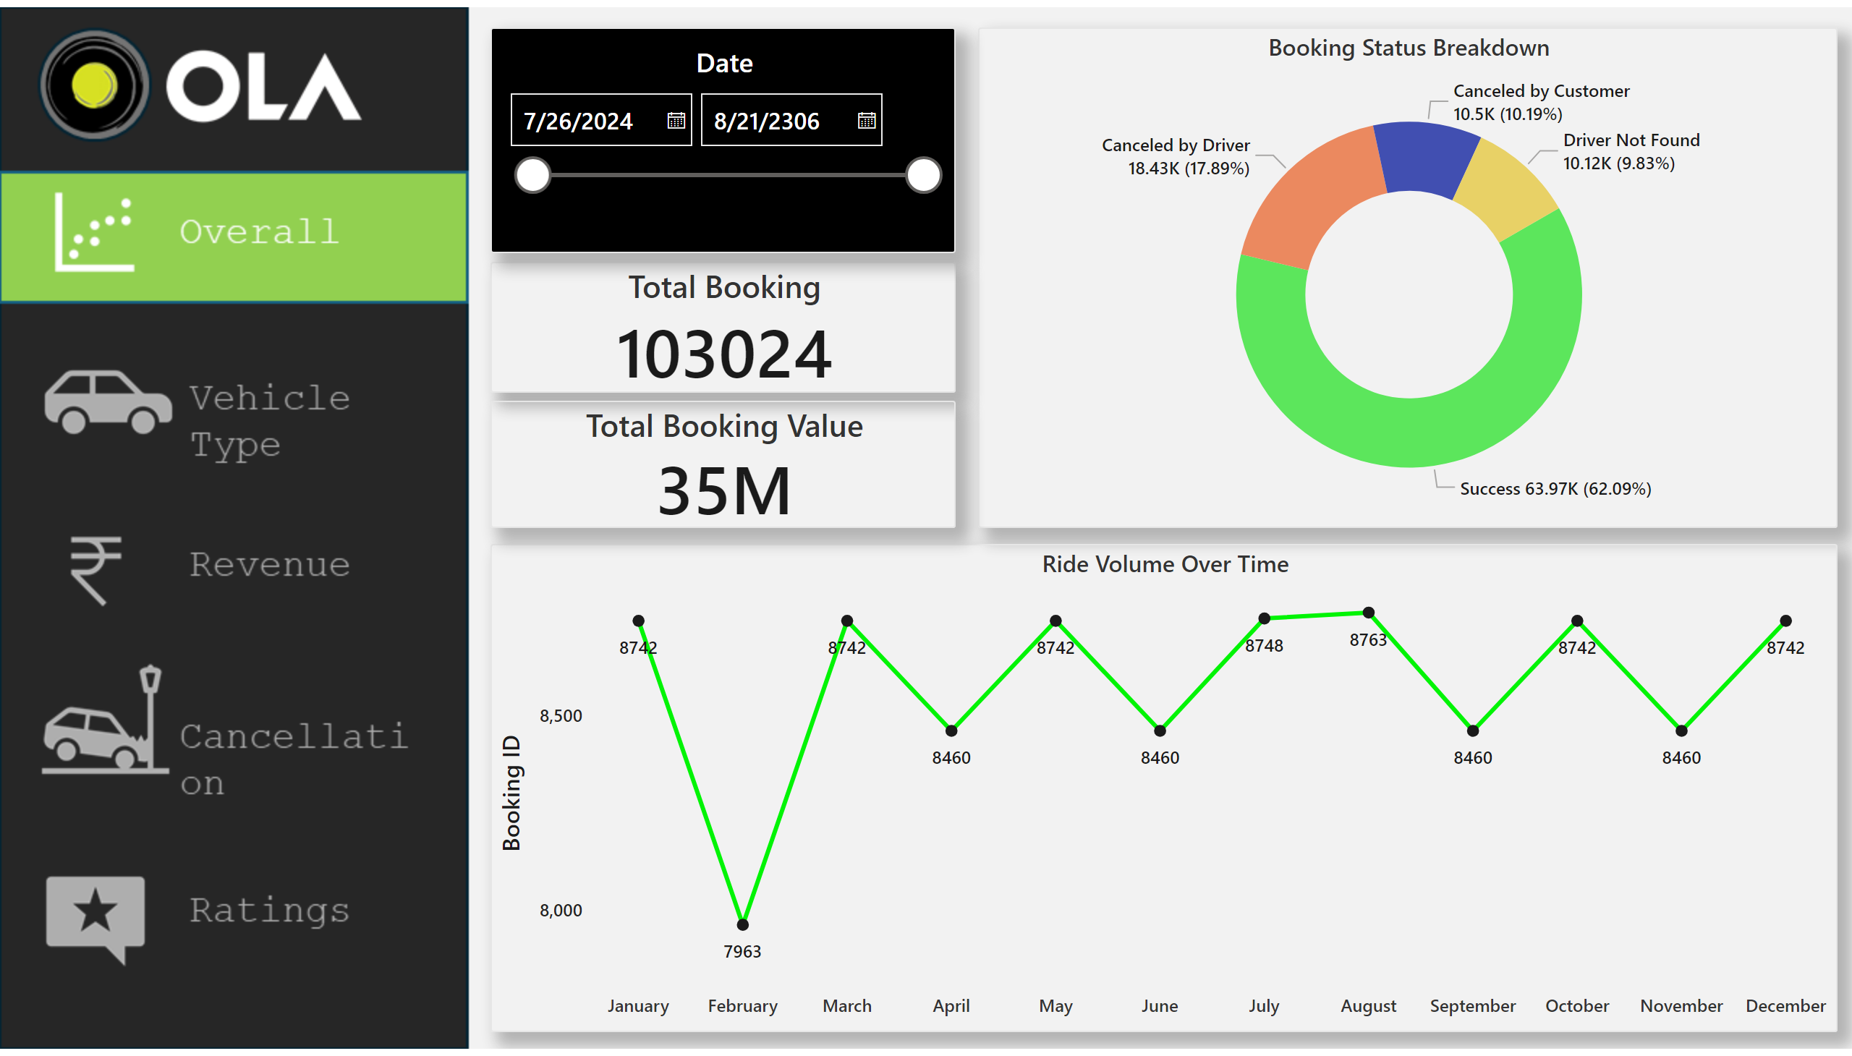
Overall
Notes:
actionButton
No alt text provided
actionButton
No alt text provided
actionButton
No alt text provided
actionButton
No alt text provided
Ride Volume Over Time
No alt text provided
Total Booking
No alt text provided
Booking Status Breakdown
No alt text provided
Date
No alt text provided
Total Booking Value
No alt text provided

Slide 3
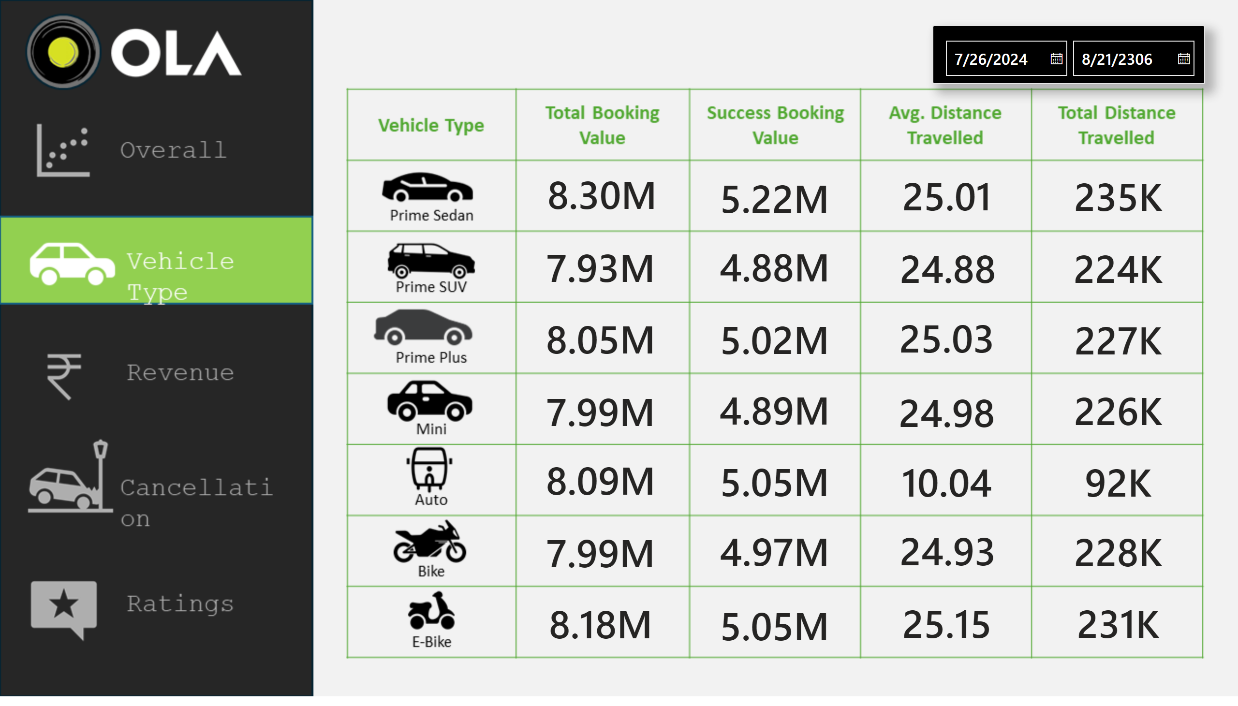
Vehicle Type
Notes:
actionButton
No alt text provided
actionButton
No alt text provided
actionButton
No alt text provided
actionButton
No alt text provided
card
No alt text provided
card
No alt text provided
card
No alt text provided
card
No alt text provided
card
No alt text provided
card
No alt text provided
card
No alt text provided
card
No alt text provided
card
No alt text provided
card
No alt text provided
card
No alt text provided
card
No alt text provided
card
No alt text provided
card
No alt text provided
card
No alt text provided
card
No alt text provided
card
No alt text provided
card
No alt text provided
card
No alt text provided
card
No alt text provided
card
No alt text provided
card
No alt text provided
card
No alt text provided
card
No alt text provided
card
No alt text provided
card
No alt text provided
card
No alt text provided
card
No alt text provided
Date
No alt text provided

Slide 4
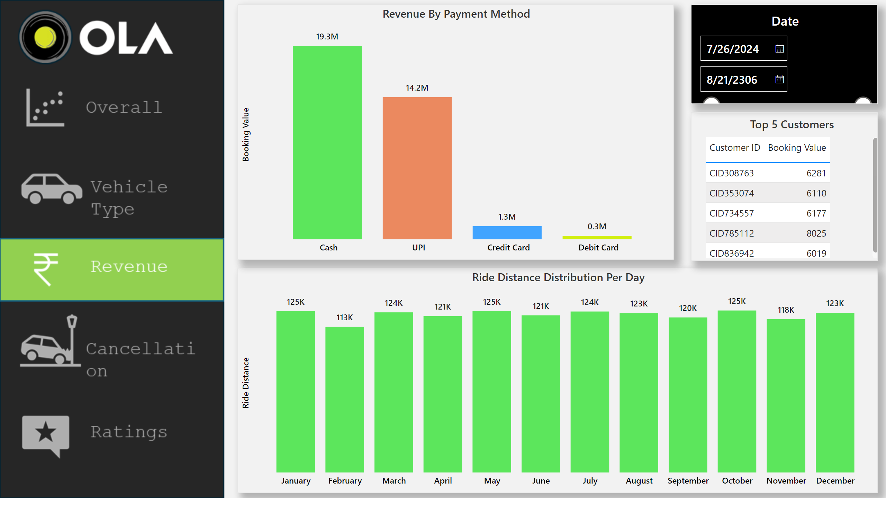
Revenue
Notes:
actionButton
No alt text provided
actionButton
No alt text provided
actionButton
No alt text provided
actionButton
No alt text provided
Revenue By Payment Method
No alt text provided
Ride Distance Distribution Per Day
No alt text provided
Date
No alt text provided
Top 5 Customers
No alt text provided

Slide 5
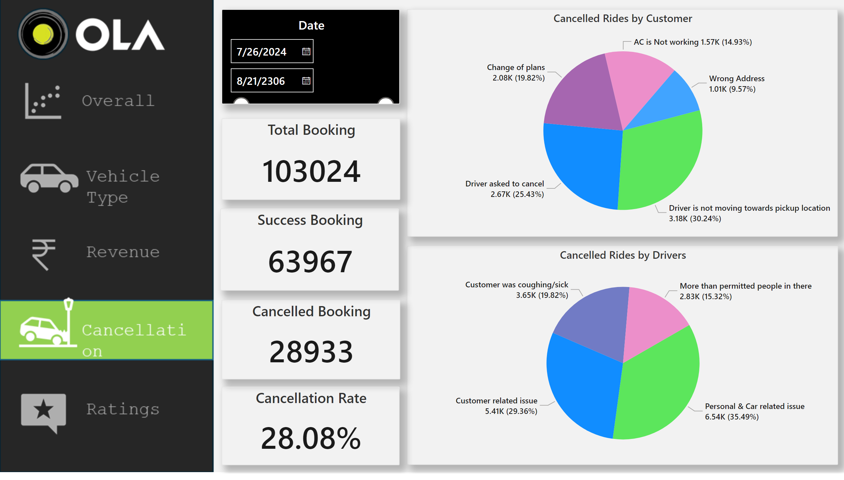
Cancellation
Notes:
actionButton
No alt text provided
actionButton
No alt text provided
actionButton
No alt text provided
actionButton
No alt text provided
Cancelled Rides by Customer
No alt text provided
Cancelled Rides by Drivers
No alt text provided
Date
No alt text provided
Total Booking
No alt text provided
Success Booking
No alt text provided
Cancelled Booking
No alt text provided
Cancellation Rate
No alt text provided

Slide 6
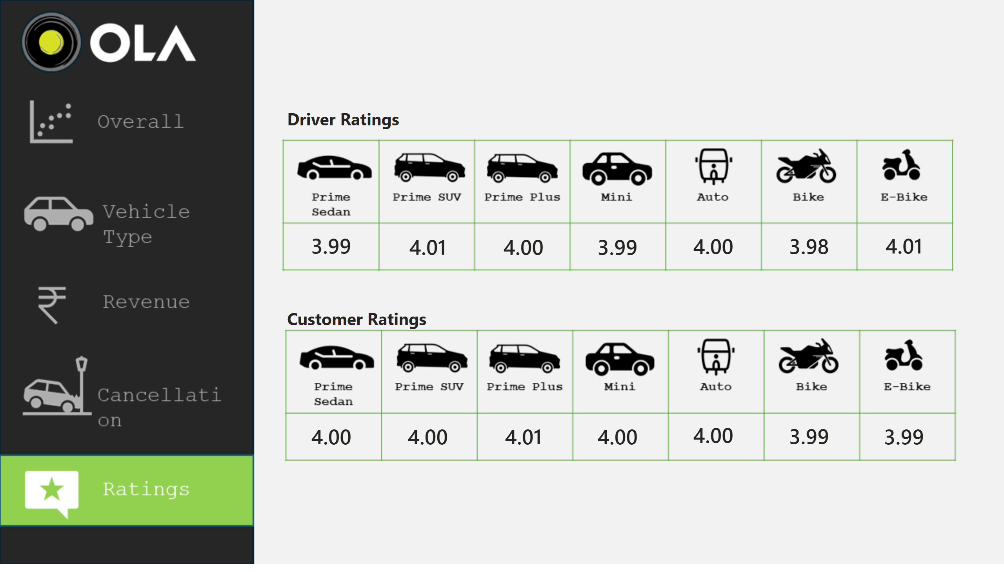
Ratings
Notes:
actionButton
No alt text provided
actionButton
No alt text provided
actionButton
No alt text provided
actionButton
No alt text provided
actionButton
No alt text provided
card
No alt text provided
card
No alt text provided
card
No alt text provided
card
No alt text provided
card
No alt text provided
card
No alt text provided
card
No alt text provided
card
No alt text provided
card
No alt text provided
card
No alt text provided
card
No alt text provided
card
No alt text provided
card
No alt text provided
card
No alt text provided
textbox
No alt text provided
textbox
No alt text provided

